Slide 1
IT VEDANT • SQL / MYSQL PROJECT
01
Student Management System
MySQL Database Project
500 Students
6 Courses
1,933 Enrollments
Presented by Arshad Mansuri • Database: MySQL

Slide 2
01 • OVERVIEW
02
Project Overview
A relational Student Management System built for SQL practice and presentation.
Students
500 records
Courses
6 programs
Departments
3 departments
Faculty
30 records
Enrollments
1,933 records

Slide 3
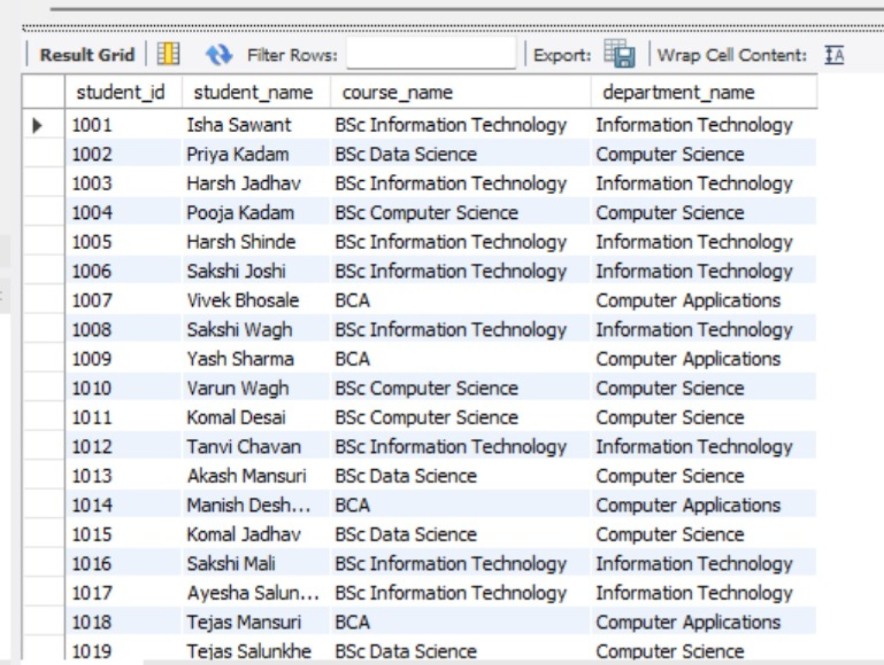
SQL QUERY 1
01
Student Course & Department Details
How can we display each student's name along with the course and department they belong to?
SELECT
s.student_id,
s.student_name,
c.course_name,
d.department_name
FROM students s
INNER JOIN courses c
ON s.course_id = c.course_id
INNER JOIN departments d
ON c.department_id = d.department_id;
MYSQL WORKBENCH OUTPUT
Actual MySQL Workbench output
INSIGHT
The result confirms that Students, Courses and Departments are correctly connected. Each student can be traced to a course and its department.

Slide 4
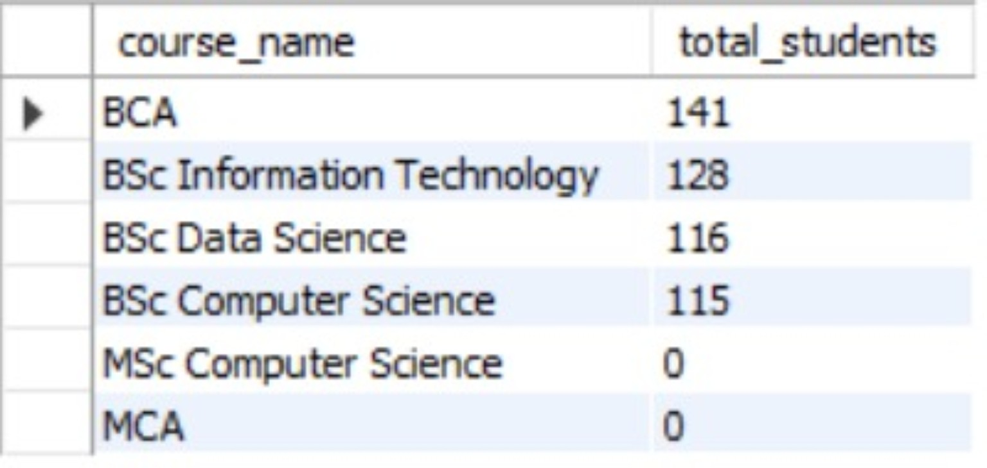
SQL QUERY 2
02
Number of Students in Each Course
How many students are enrolled in each course, including courses that currently have no students?
SELECT
c.course_name,
COUNT(s.student_id) AS total_students
FROM courses c
LEFT JOIN students s
ON c.course_id = s.course_id
GROUP BY c.course_id, c.course_name
ORDER BY total_students DESC;
MYSQL WORKBENCH OUTPUT
Actual MySQL Workbench output
INSIGHT
BCA has the highest count with 141 students, followed by BSc Information Technology (128), BSc Data Science (116) and BSc Computer Science (115). MSc Computer Science and MCA have 0 students.

Slide 5
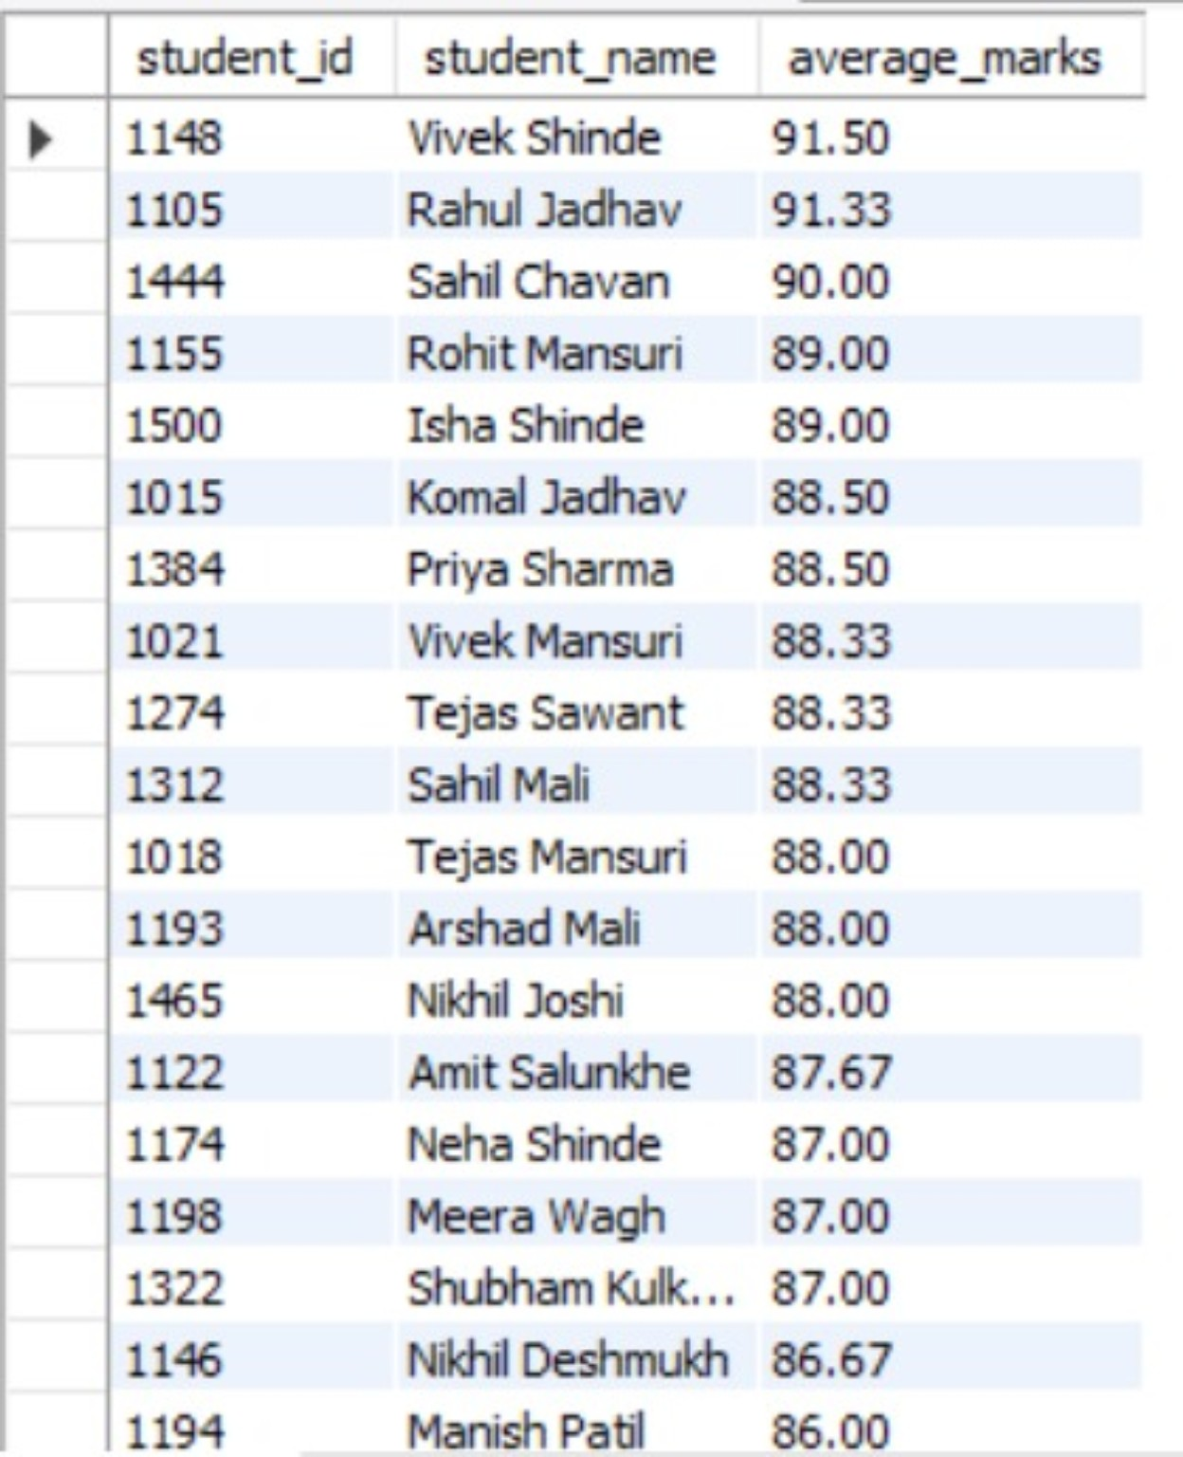
SQL QUERY 3
03
Average Marks of Students
What is the average mark obtained by each student, ranked from highest to lowest?
SELECT
s.student_id,
s.student_name,
ROUND(AVG(e.total_marks), 2) AS average_marks
FROM students s
INNER JOIN enrollments e
ON s.student_id = e.student_id
GROUP BY s.student_id, s.student_name
ORDER BY average_marks DESC;
MYSQL WORKBENCH OUTPUT
Actual MySQL Workbench output
INSIGHT
The output ranks students by academic performance. The highest visible average is 91.50 for Vivek Shinde, followed by Rahul Jadhav at 91.33.

Slide 6
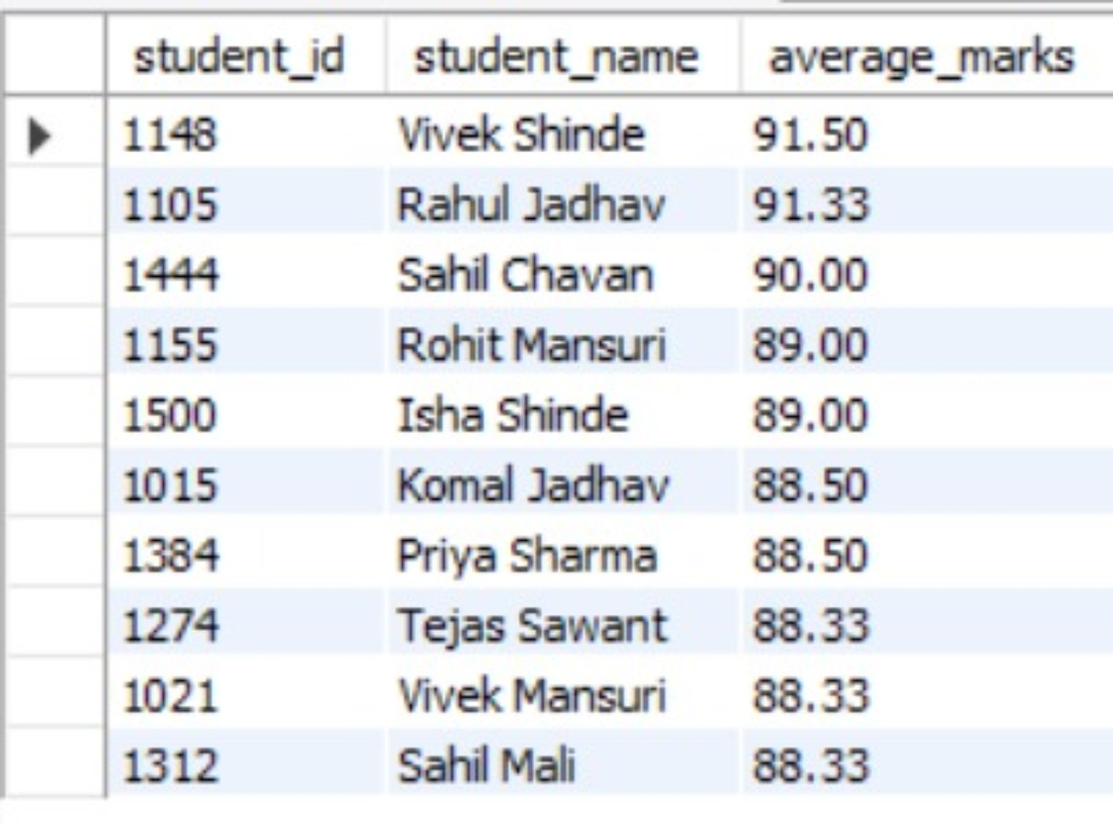
SQL QUERY 4
04
Top 10 Students by Average Marks
Who are the top 10 students based on their average marks?
SELECT
s.student_id,
s.student_name,
ROUND(AVG(e.total_marks), 2) AS average_marks
FROM students s
INNER JOIN enrollments e
ON s.student_id = e.student_id
GROUP BY s.student_id, s.student_name
ORDER BY average_marks DESC
LIMIT 10;
MYSQL WORKBENCH OUTPUT
Actual MySQL Workbench output
INSIGHT
The query identifies the top-performing students by sorting average marks in descending order and limiting the result to the top 10.

Slide 7
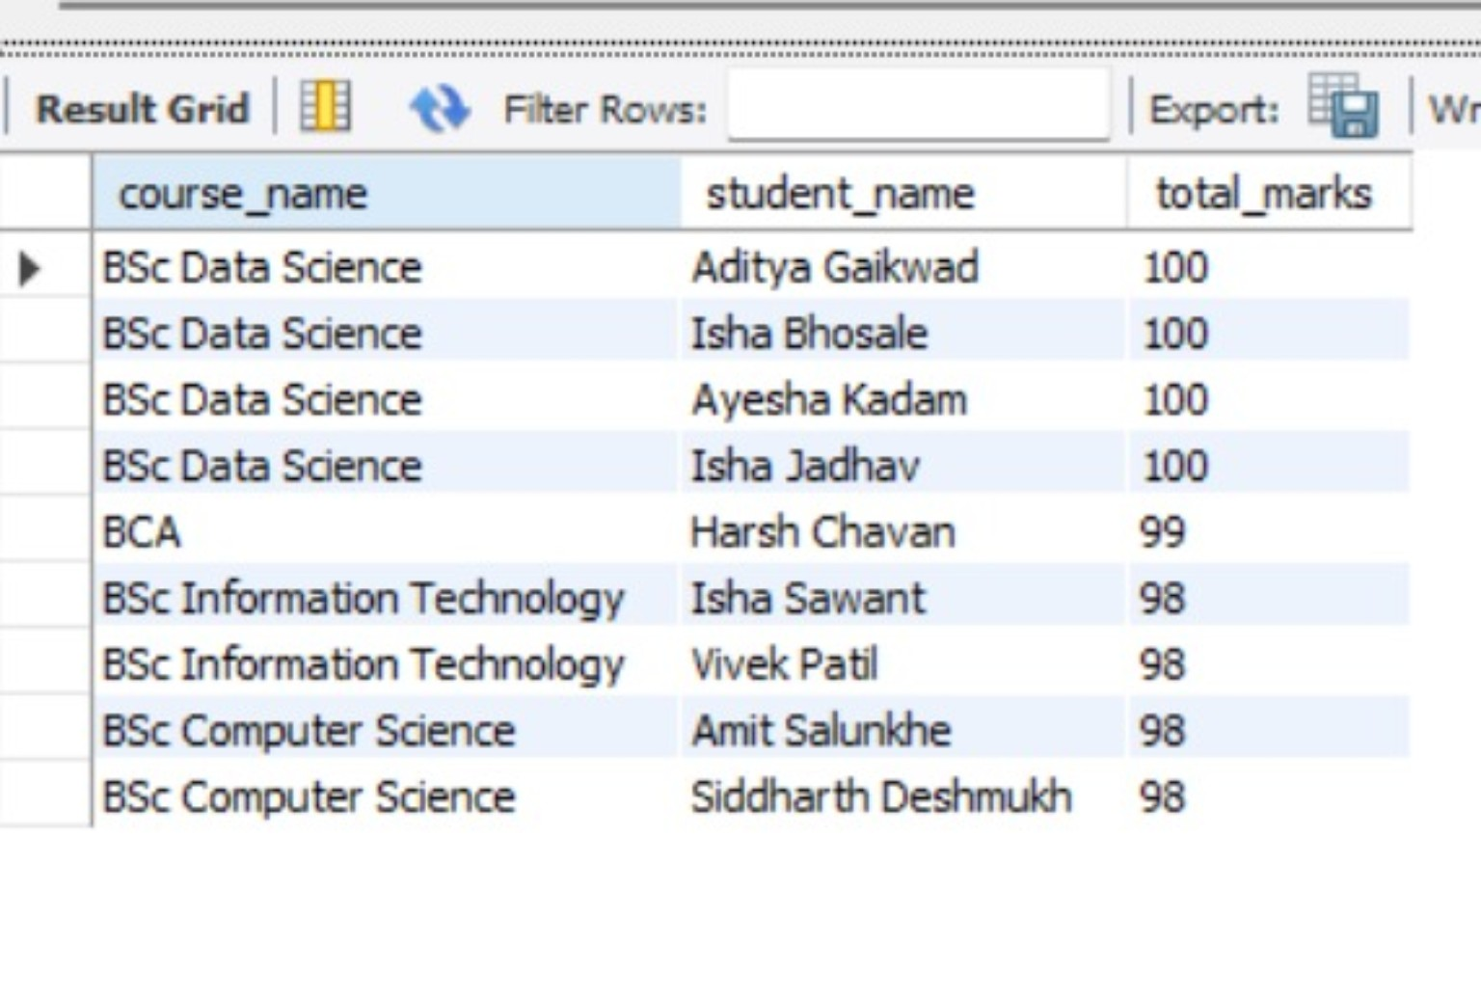
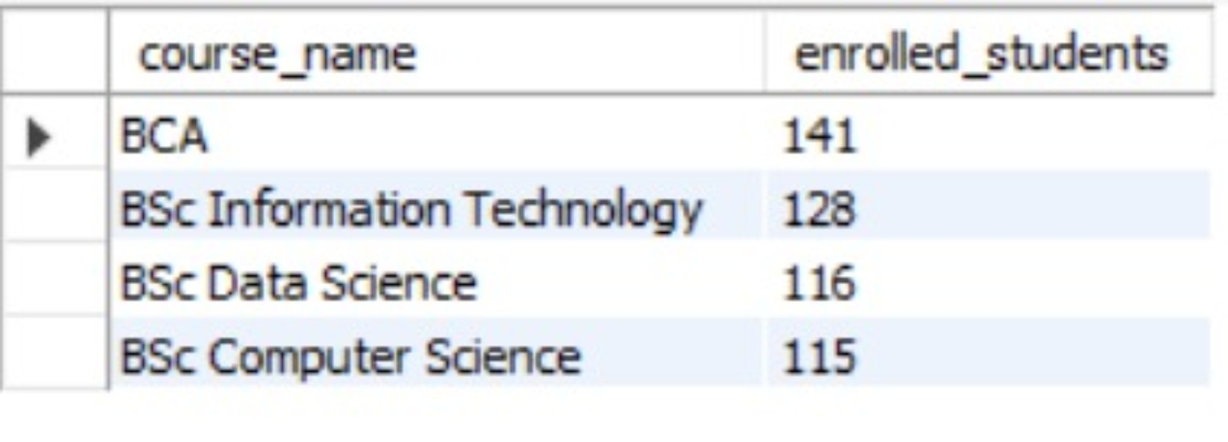
SQL QUERY 5
05
Highest Scoring Student in Each Course
Who is the highest-scoring student in each course?
SELECT
c.course_name,
s.student_name,
e.total_marks
FROM enrollments e
INNER JOIN students s
ON e.student_id = s.student_id
INNER JOIN courses c
ON e.course_id = c.course_id
WHERE e.total_marks = (
SELECT MAX(e2.total_marks)
FROM enrollments e2
WHERE e2.course_id = e.course_id
)
ORDER BY e.total_marks DESC;
MY OUTPUT — MYSQL WORKBENCH
Highest mark from each course; ties are included.
INSIGHT
BSc Data Science has four students with the highest score of 100. BCA has a highest score of 99, while BSc Information Technology and BSc Computer Science have highest scores of 98. If marks are tied, the query correctly returns all students with that course's maximum mark.

Slide 8
07 • CONCLUSION
Conclusion
• The Student Management System successfully connects students, courses, departments, faculty and enrollments.
• The project demonstrates SQL concepts such as JOIN, LEFT JOIN, GROUP BY, aggregate functions, ORDER BY and LIMIT.
• The queries help analyze student distribution, course enrollment and academic performance.
• The database can be extended with attendance, fees, examinations and other college management modules.
Overall: A practical MySQL project demonstrating relational database and SQL analysis skills.

Slide 9
IT VEDANT • SQL / MYSQL PROJECT
09
Thank You!
Student Management System
Presented by Arshad Mansuri
IT Vedant • MySQL Project

